Slide 1


SPARKIO
(Transforming the Digital Shopping Experience)
Instructor name: Mr. Lavish Arora
Alisha Gupta | 2110990142 | G5

Slide 2
CONTENTS
WHY SPARKIO
GOALS &
OBJECTIVES
TECHNOLOGY
USED
INTRODUCTION
CUSTOMER
SUPPORT
TARGET AUDIENCE
CHALLENGES
USED
SNEEK PEEK
INTRODUCTION
FUTURE
SCOPE

Slide 3


SPARKIO-
Your Ultimate Tech Marketplace
Your One-Stop Shop for Diverse Electronics Selections.
The Ultimate Destination for Cutting-Edge Electronics.
Explore Premium Headphones, Smartphones, Appliances, and Cameras.

Slide 4





WHY SPARKIO?
Sparkio: Where Quality Meets Commitment.
Unmatched Customer Service: Your Satisfaction, Our Priority.
Diverse Product Range, Infinite Possibilities.
From Headphones to Smartphones, Innovation Awaits.
Innovative Home Appliances: Elevate Your Living.
Capture Moments with High-Performance Cameras

Slide 5

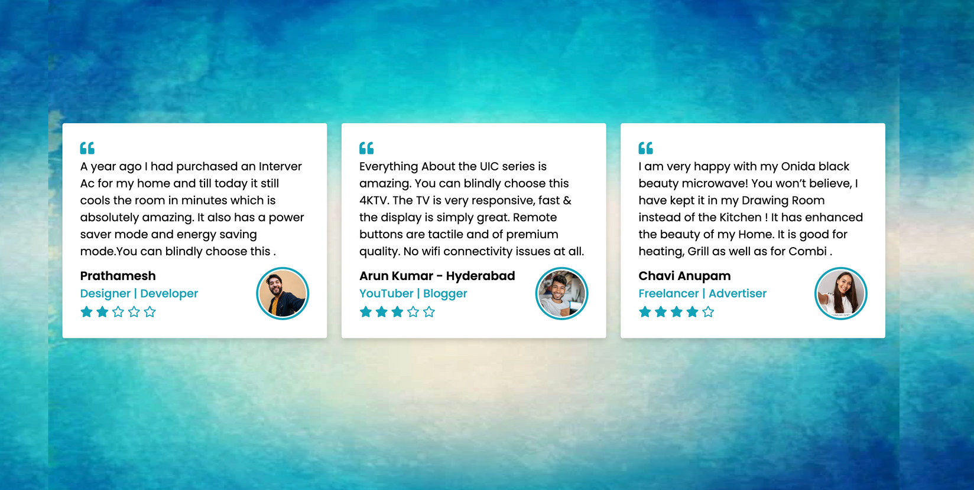
GOALS AND OBJECTIVES
User Satisfaction
Quality Products
Secure Transactions
Customer Engagement
Comprehensive Product View

Slide 6




TECHNOLOGIES USED
Sparkio is built on a foundation of cutting-edge technologies and functionalities that contribute to its robustness and versatility.
Key technologies used include:
HTML
CSS
JavaScript
Jquery
Bootstrap

Slide 7

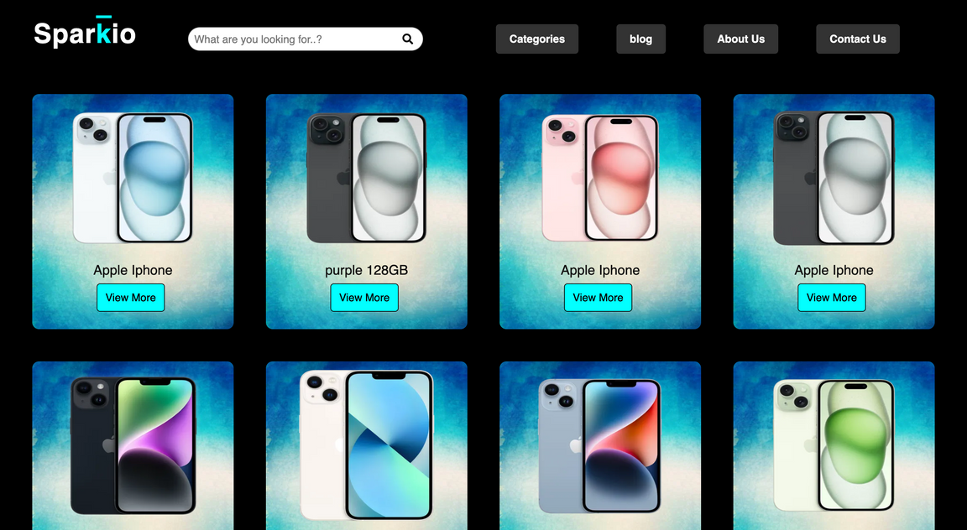
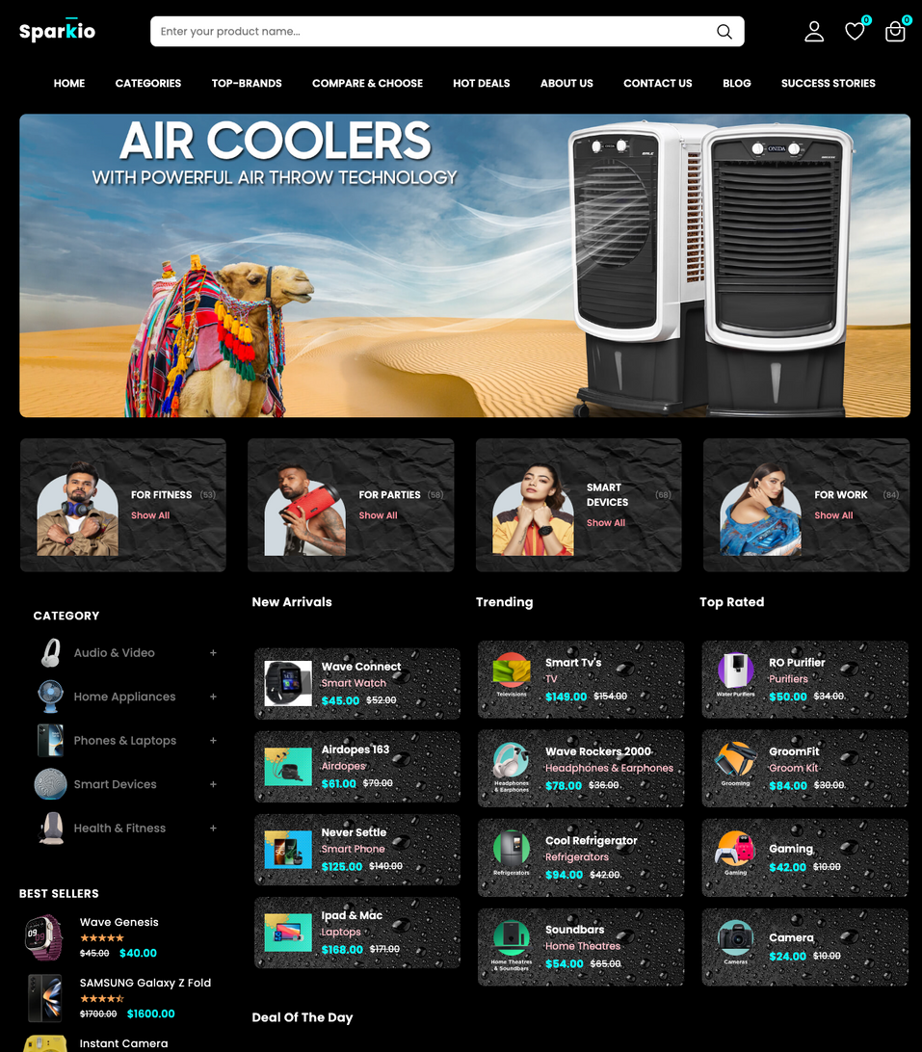
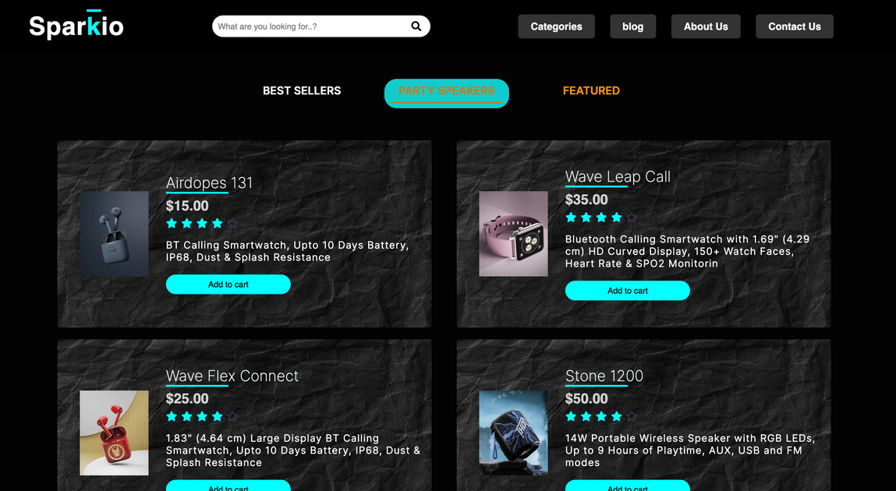

SNEAK PEEK INTO SPARKIO

Slide 8
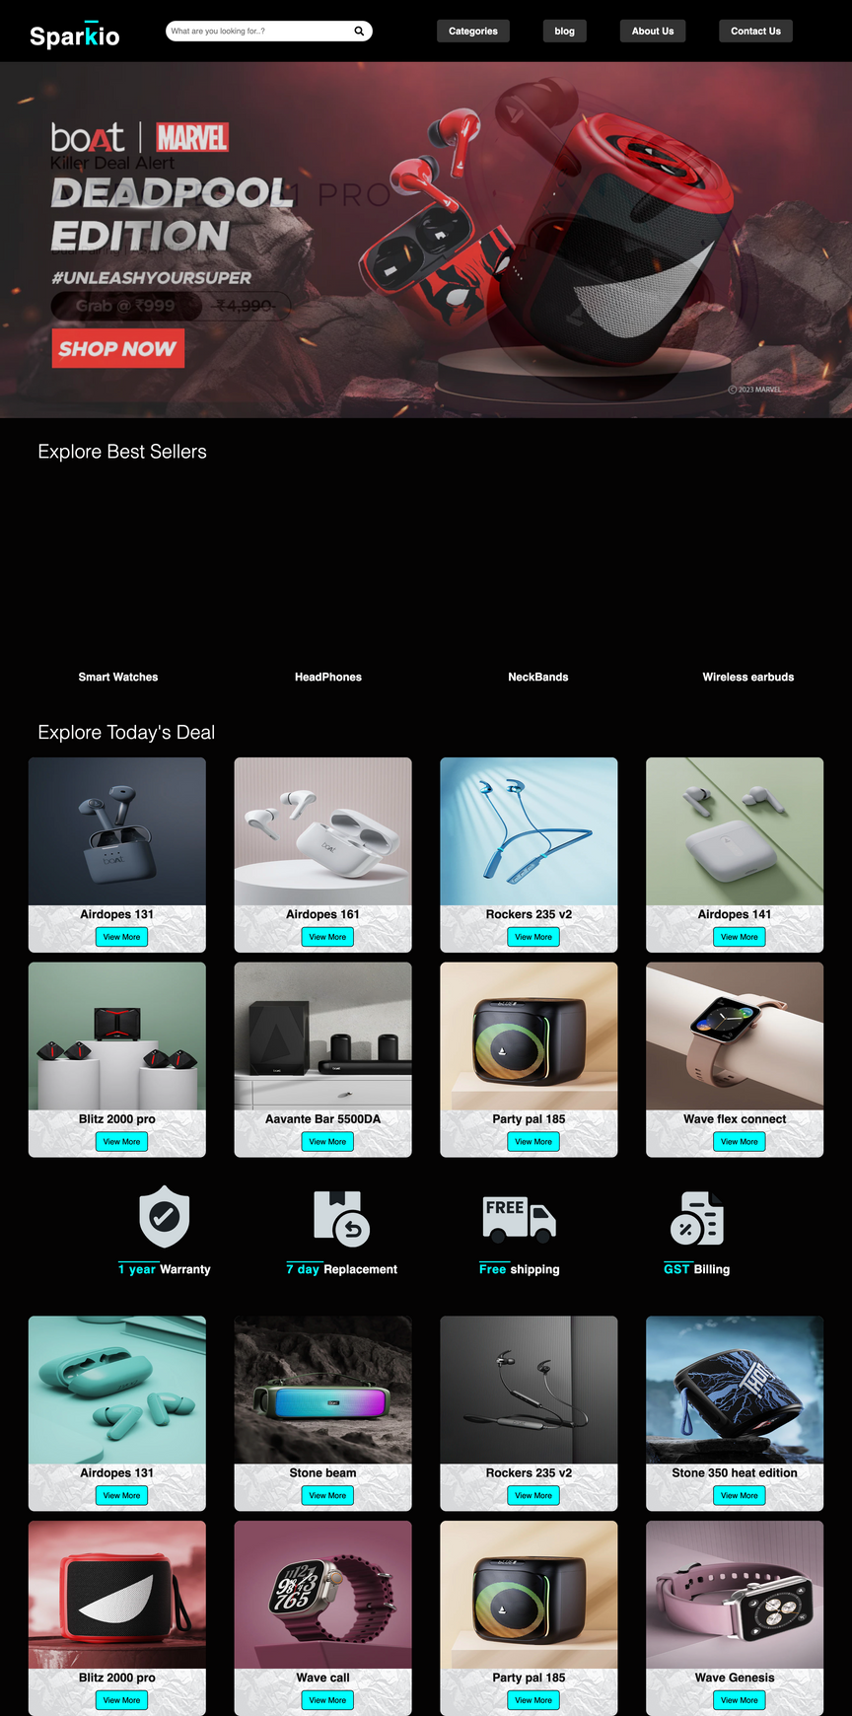
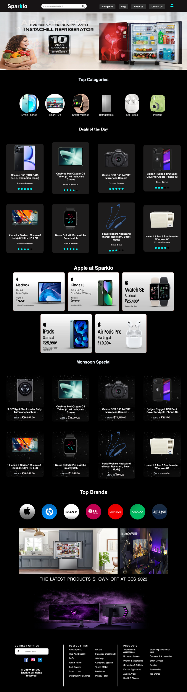

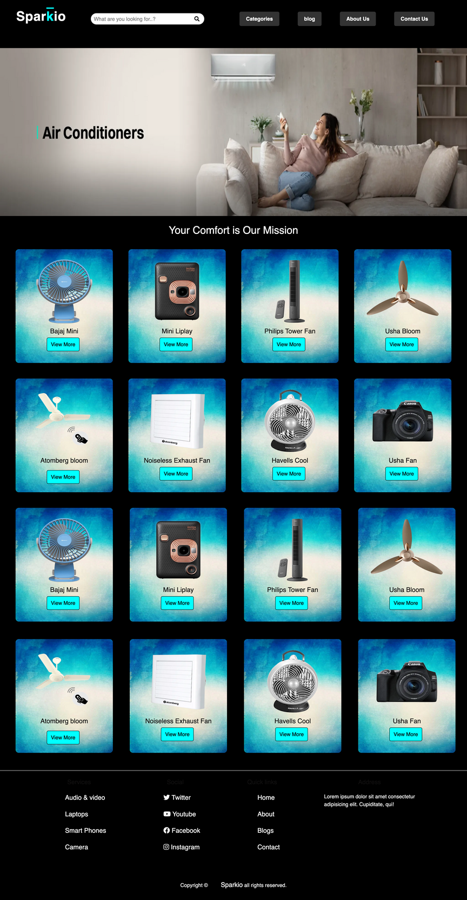
SNEAK PEEK INTO SPARKIO

Slide 9
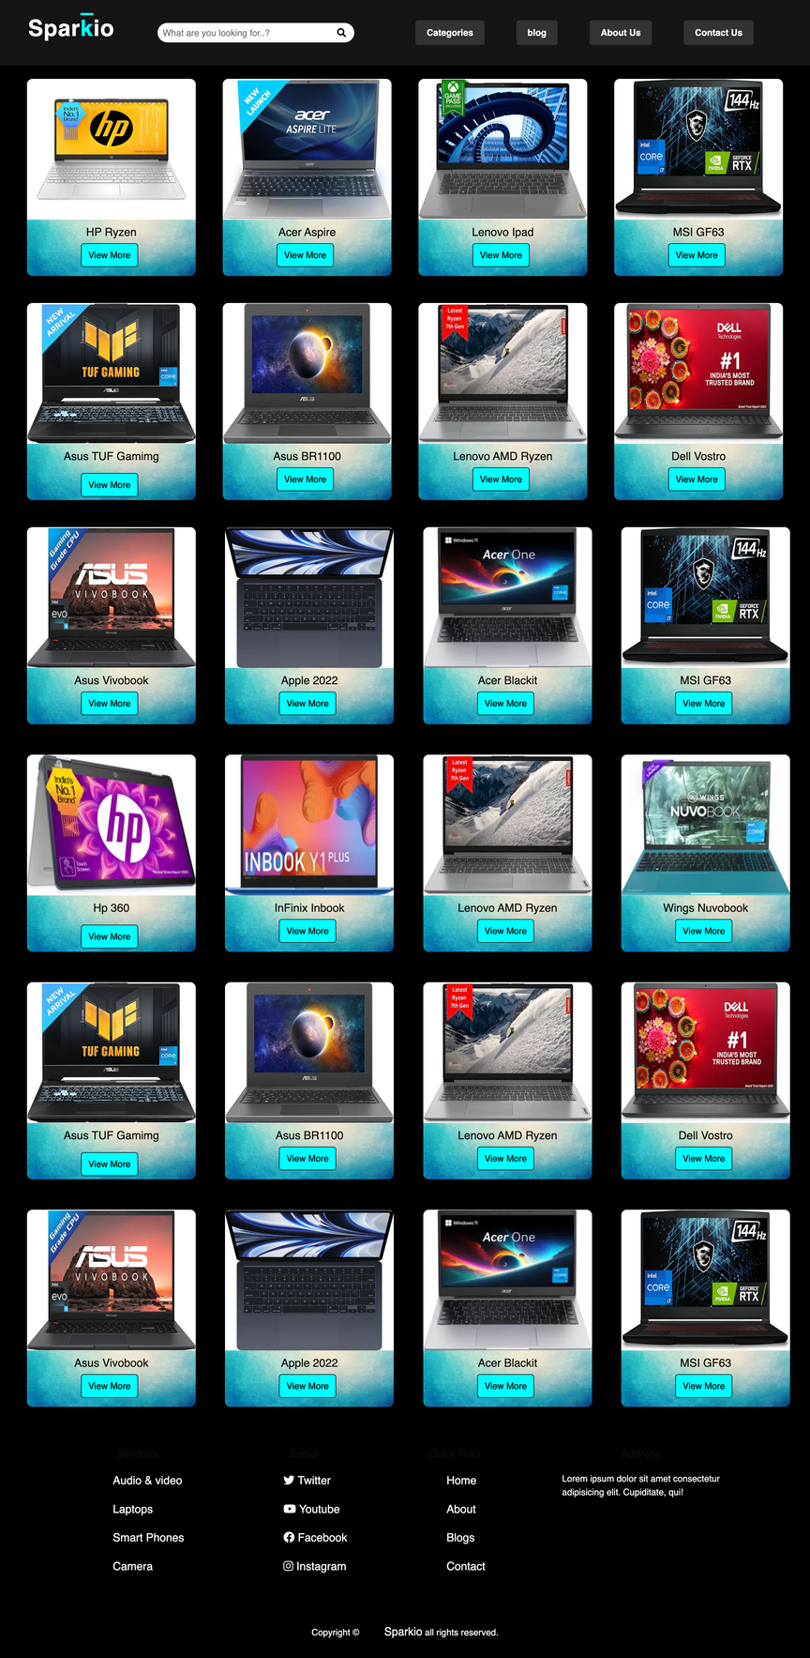
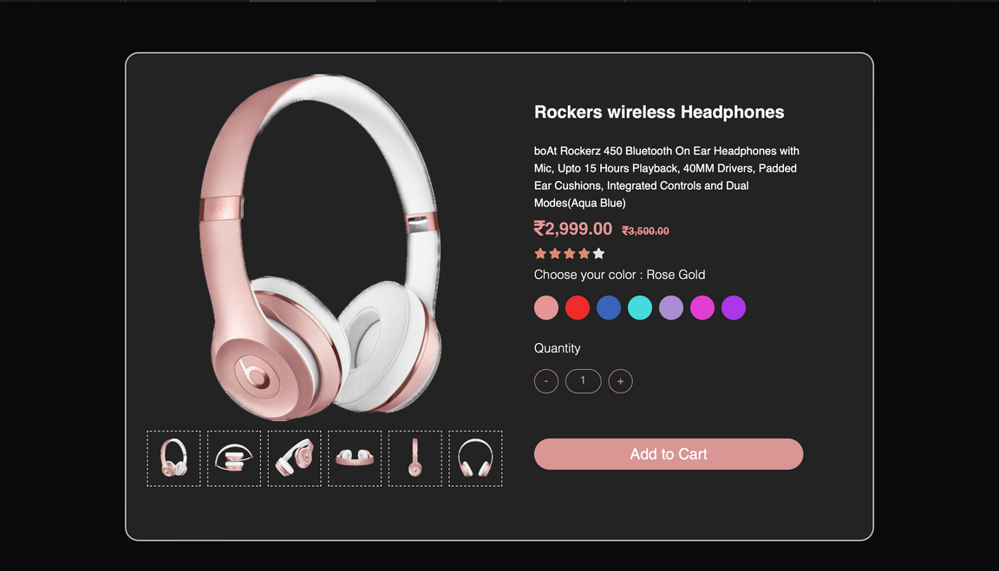
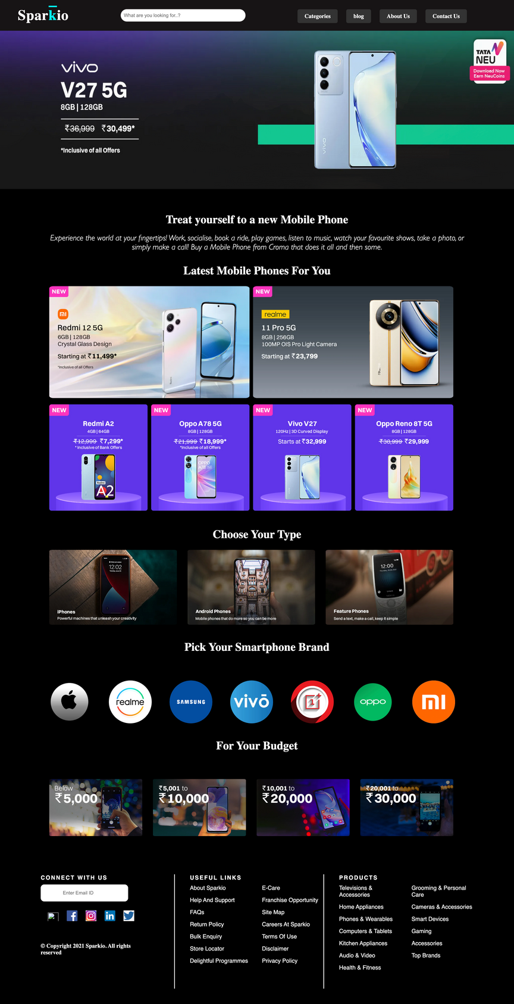
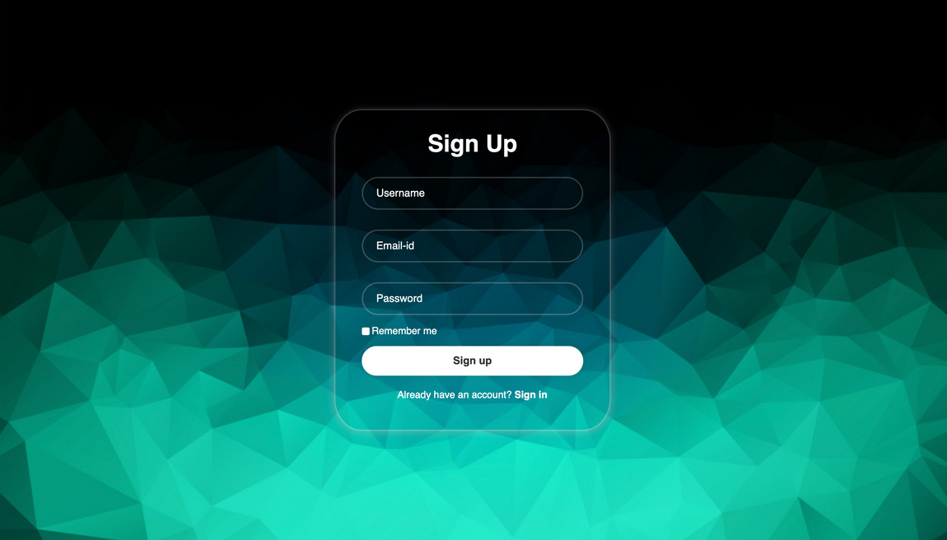
SNEAK PEEK INTO SPARKIO

Slide 10


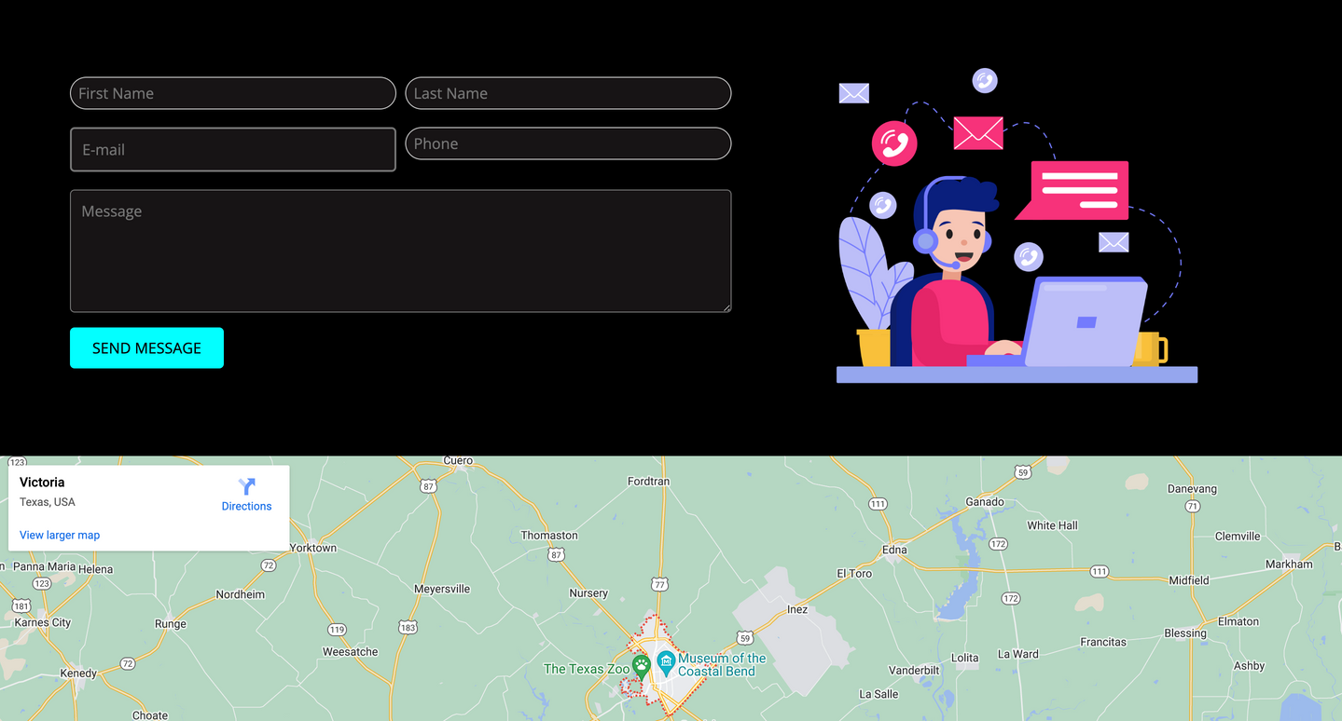

CUSTOMER SUPPORT
Offering prompt and efficient customer support was a challenge, but it was one we tackled head-on.
Our dedicated customer support team is readily available to address customer inquiries and concern

Slide 11

TARGET AUDIENCE
Our platform is designed for tech enthusiasts and electronics shoppers
Mainly ages 18-50 with an interest in the latest gadgets and technology."
Interests: "Interest in electronics, gadgets, and convenient online shopping.

Slide 12

CHALLENGES FACED
Product Sourcing
User Experience
Mobile Responsiveness
Content Creation
Payment Integration
Scaling Issues

Slide 13

FUTURE SCOPE
Mobile App
Voice Search
One-Click Shopping
User-Generated Content
Dynamic Pricing:

Slide 14

Thank's For Watching
Connect with us.
sparkio@gmail.com

